Slide 1
Full Adder
Everett Jones
11/29/17
ECE 09:414
Electronics II – VLSI Circuit Design
(Fall 2017)
Instructor: Dr. H. Hanafi & Adam Fifth
Henry M. Rowan College of Engineering Department of ECE Rowan University

Slide 2
Outline
What is a Full Adder?
Design of a Full Adder
Optimal design
Standard Cell

Slide 3
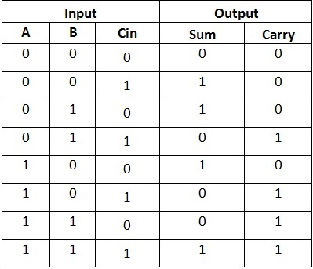
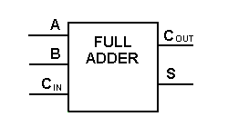
Block Diagram and Truth Table

Slide 4
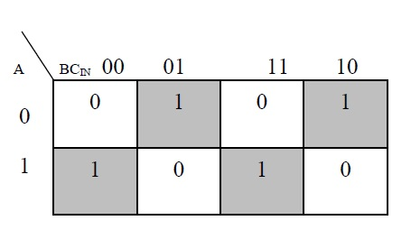
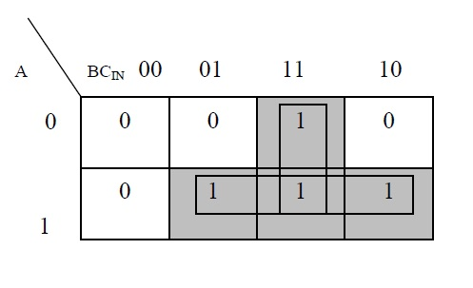

Minimization Using K-Map
$$S=A\overline{B}\overline{C}+\overline{A}B\overline{C}+\overline{A}\overline{B}C+ABC$$
$$C_{Out}=AB+AC+BC$$

Slide 5
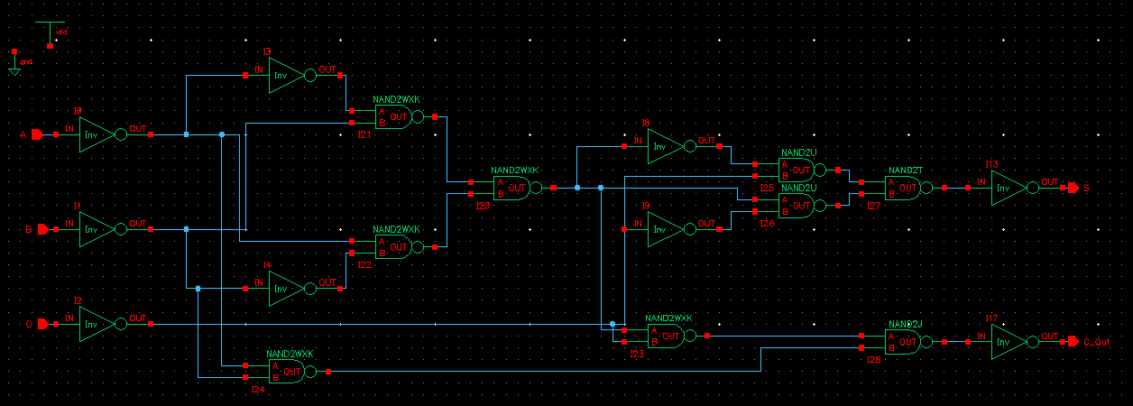
Logic Design

Slide 6
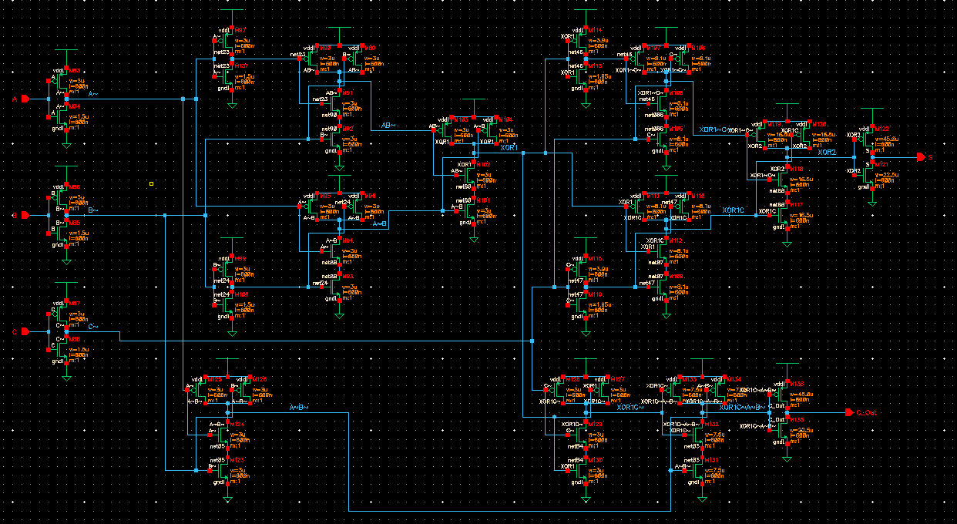
Transistor Design

Slide 7
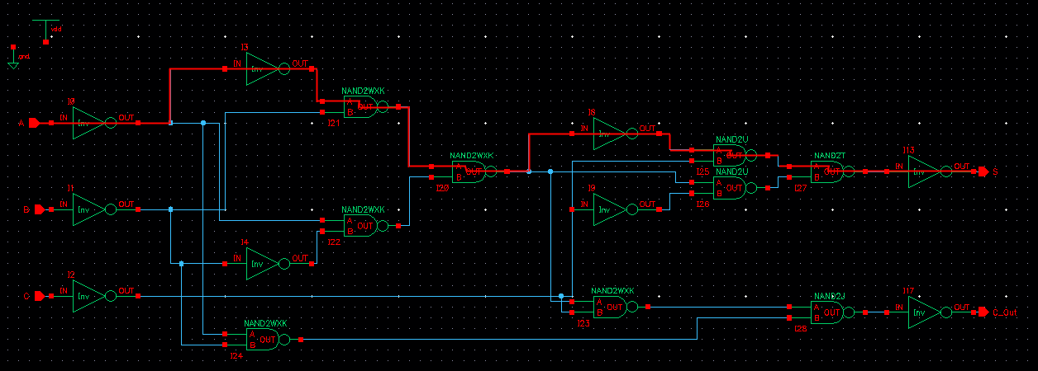
Worst Case Logical Path

Slide 8
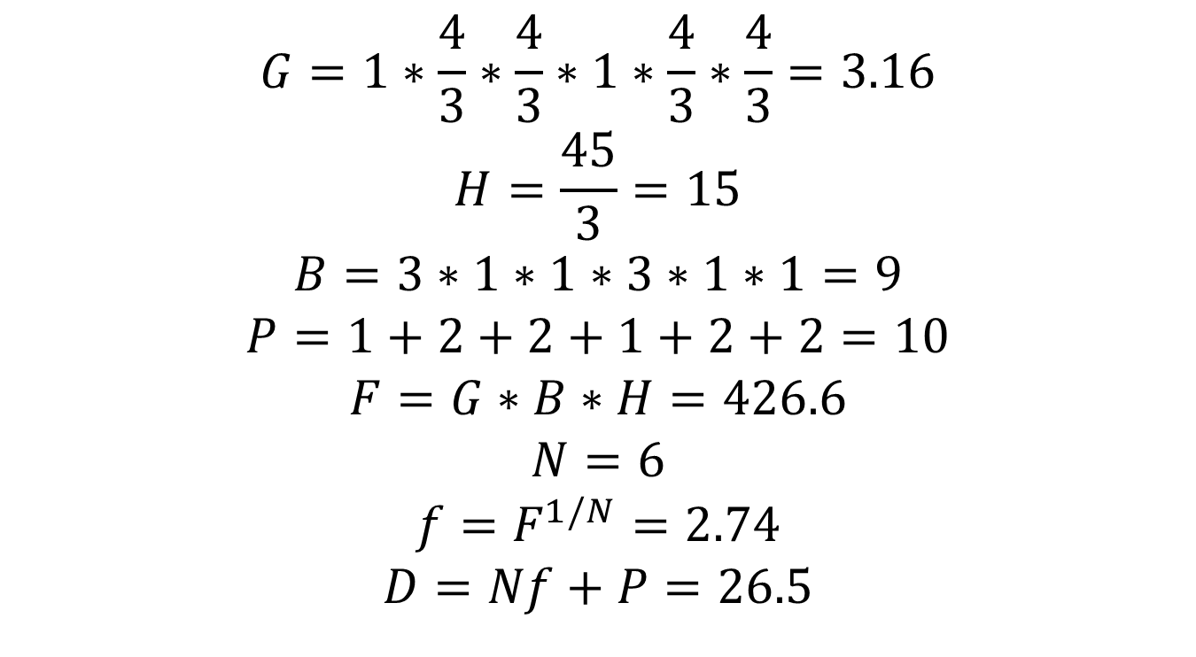
Logical Effort, Number of Stages, Delay
$$G=1∗\frac{4}{3}∗\frac{4}{3}∗1∗\frac{4}{3}∗\frac{4}{3}=3.16$$
$$H=\frac{45}{3}=15$$
$$B=3∗1∗1∗3∗1∗1=9$$
$$P=1+2+2+1+2+2=10$$
$$F=G∗B∗H=426.6$$
$$N=6$$
$$f=F^{1/N}=2.74$$
$$D=Nf+P=26.5$$

Slide 9
Spreadsheet Comparing Different Designs
Design | N | G | P | D
NAND2-NAND2-NAND2-NAND2-NAND2-NAND2 | 6 | 5.62 | 10 | 32.86
INV-NAND3-INV-NOR4 | 4 | 5 | 9 | 28.8
INV-NAND3-INV-NOR4-INV-INV | 6 | 5 | 11 | 28.43
INV-NAND2-NAND2-INV-NAND2-NAND2 | 6 | 3.16 | 10 | 26.5
INV-NAND2-NAND2-INV-NAND2-NAND2-INV-INV | 8 | 3.16 | 12 | 29.05

Slide 10
Gate Sizes For Optimized Design
Component | Cin | C-Ratio | Size Ratio
Nand2J | 6.7 | 5:5 | 7.5:7.5
Nand2K | 1 | 2:2 | 3:3
InvS | 45 | 30:15 | 45:22.5
Nand2T | 21.9 | 10.95:10.95 | 16.5:16.5
Nand2U | 10.66 | 5.33:5.33 | 8:8
InvV | 3.89 | 2.6:1.3 | 3.9:1.95
Nand2W | 1.89 | 2:2 | 3:3
Nand2X | 0.92 | 2:2 | 3:3
InvY | 0.34 | 2:2 | 3:3
InvZ | 3 | 2:1 | 3:1.5

Slide 11

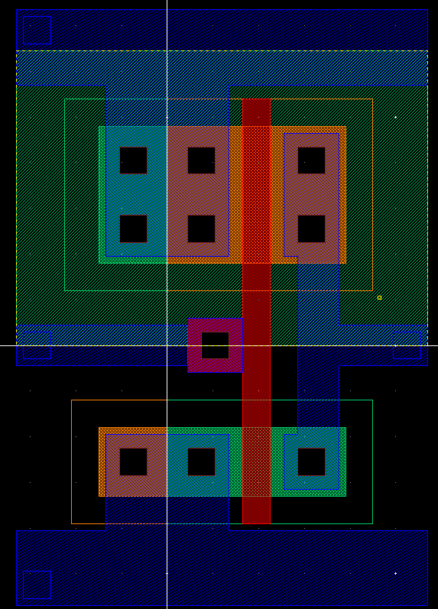
Standard Cell Library Layouts

Slide 12
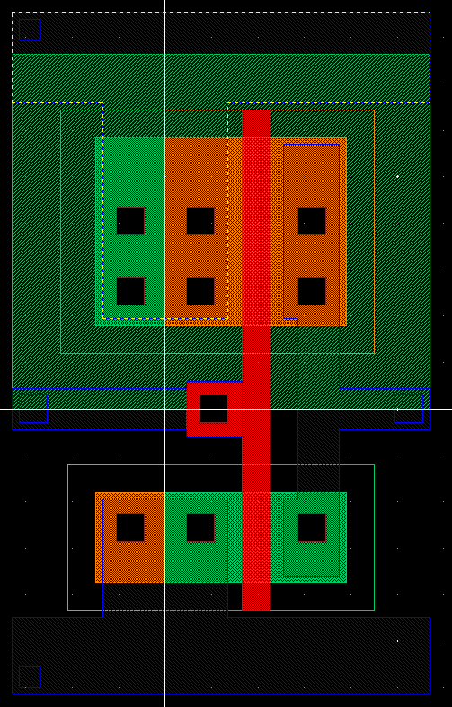
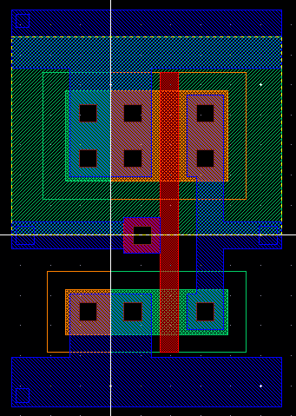
Standard Cell Library Layouts

Slide 13
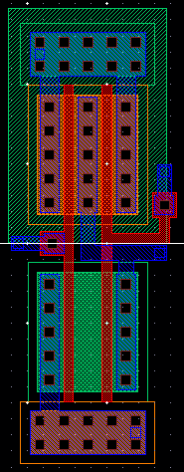
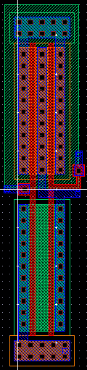
Standard Cell Library Layouts

Slide 14
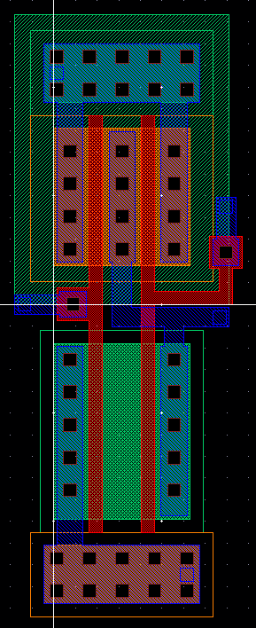
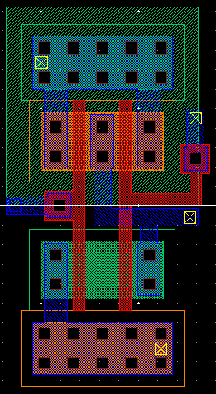
Standard Cell Library Layouts

Slide 15

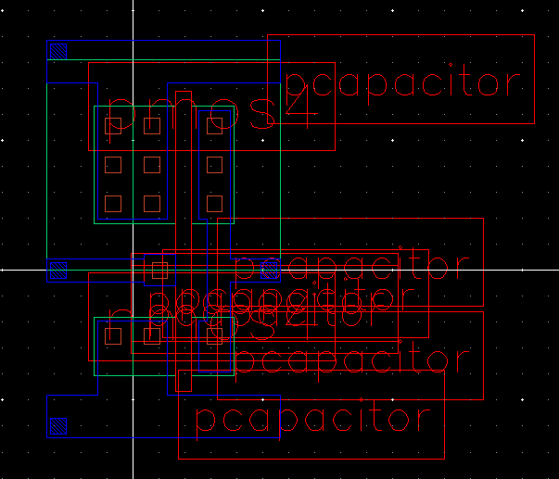
Standard Cell Library Extracted Layouts

Slide 16
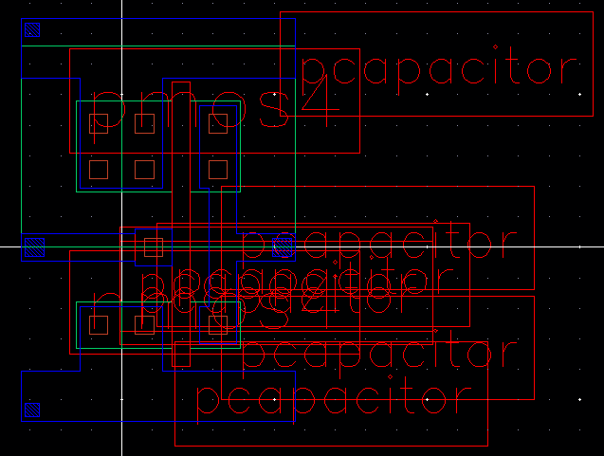
Standard Cell Library Extracted Layouts

Slide 17
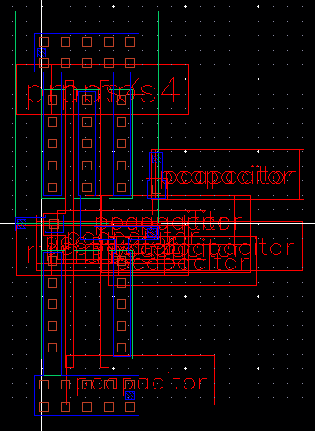
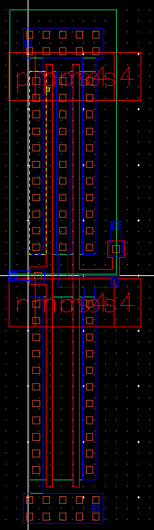
Standard Cell Library Extracted Layouts

Slide 18
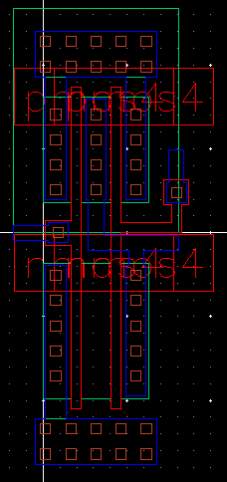
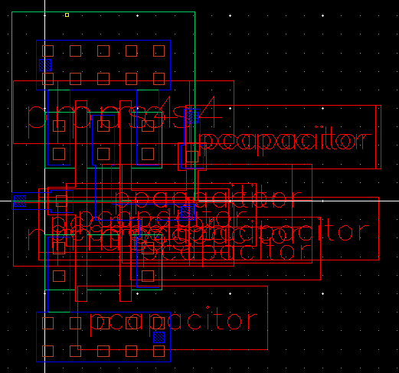
Standard Cell Library Extracted Layouts

Slide 19
Standard Cell Library Simulation “Spectre” Netlist
\+205 (gnd! 23) capacitor c=2.28082e-16 m=1
\+204 (gnd! 22) capacitor c=2.38545e-16 m=1
\+203 (gnd! 21) capacitor c=2.40637e-16 m=1
\+202 (gnd! 20) capacitor c=2.28082e-16 m=1
\+201 (gnd! 19) capacitor c=2.7621e-16 m=1
\+200 (gnd! 18) capacitor c=3.47355e-16 m=1
\+199 (gnd! 17) capacitor c=2.40637e-16 m=1
\+198 (gnd! 16) capacitor c=2.38545e-16 m=1
\+197 (gnd! 15) capacitor c=7.05172e-16 m=1
\+196 (gnd! 14) capacitor c=2.38545e-16 m=1
\+195 (gnd! 13) capacitor c=2.40637e-16 m=1
\+194 (gnd! 12) capacitor c=2.38545e-16 m=1
\+193 (gnd! 11) capacitor c=2.40637e-16 m=1
\+192 (gnd! 10) capacitor c=7.09357e-16 m=1
\+191 (gnd! 9) capacitor c=7.09357e-16 m=1
\+190 (gnd! 8) capacitor c=7.05172e-16 m=1
\+189 (C gnd!) capacitor c=2.28082e-16 m=1
\+188 (B gnd!) capacitor c=2.28082e-16 m=1
\+187 (A gnd!) capacitor c=2.28082e-16 m=1
\+186 (vdd! 23) capacitor c=2.28083e-16 m=1
\+185 (vdd! 22) capacitor c=2.38545e-16 m=1
\+184 (vdd! 21) capacitor c=4.95923e-16 m=1
\+183 (vdd! 20) capacitor c=2.28083e-16 m=1
\+182 (vdd! 19) capacitor c=2.1762e-16 m=1
\+181 (vdd! 18) capacitor c=4.05945e-16 m=1
\+180 (vdd! 17) capacitor c=4.95923e-16 m=1
\+179 (vdd! 16) capacitor c=2.38545e-16 m=1
\+178 (vdd! 15) capacitor c=7.13542e-16 m=1
\+177 (vdd! 14) capacitor c=2.38545e-16 m=1
\+176 (vdd! 13) capacitor c=4.95923e-16 m=1
\+175 (vdd! 12) capacitor c=2.38545e-16 m=1
\+174 (vdd! 11) capacitor c=4.95923e-16 m=1
\+173 (vdd! 10) capacitor c=1.21993e-15 m=1
\+172 (vdd! 9) capacitor c=1.21993e-15 m=1
\+171 (vdd! 8) capacitor c=7.05172e-16 m=1
\+170 (vdd! C) capacitor c=2.28082e-16 m=1
\+169 (vdd! B) capacitor c=2.28082e-16 m=1
\+168 (vdd! A) capacitor c=2.28082e-16 m=1
\+167 (21 23) capacitor c=2.217e-16 m=1
\+166 (18 20) capacitor c=2.217e-16 m=1
\+165 (17 19) capacitor c=2.217e-16 m=1
\+164 (13 15) capacitor c=2.217e-16 m=1
\+163 (11 14) capacitor c=2.217e-16 m=1
\+162 (10 22) capacitor c=2.217e-16 m=1
\+161 (10 18) capacitor c=2.217e-16 m=1
\+160 (9 21) capacitor c=2.217e-16 m=1
\+159 (9 13) capacitor c=2.217e-16 m=1
\+158 (gnd! 23) capacitor c=2.74437e-15 m=1
\+157 (gnd! 22) capacitor c=2.54742e-15 m=1
\+156 (gnd! 21) capacitor c=7.00103e-14 m=1
\+155 (gnd! 20) capacitor c=4.26687e-15 m=1
\+154 (gnd! 19) capacitor c=2.32434e-15 m=1
\+153 (gnd! 18) capacitor c=6.95166e-14 m=1
\+152 (gnd! 17) capacitor c=6.35626e-14 m=1
\+151 (gnd! 16) capacitor c=6.53598e-14 m=1
\+150 (gnd! 15) capacitor c=7.62512e-14 m=1
\+149 (gnd! 14) capacitor c=2.29578e-15 m=1
\+148 (gnd! 13) capacitor c=6.48827e-14 m=1
\+147 (gnd! 12) capacitor c=1.83021e-15 m=1
\+146 (gnd! 11) capacitor c=6.24453e-14 m=1
\+145 (gnd! 10) capacitor c=9.11812e-14 m=1
\+144 (gnd! 9) capacitor c=9.10467e-14 m=1
\+143 (gnd! 8) capacitor c=8.32562e-14 m=1
\+142 (S gnd!) capacitor c=5.53442e-14 m=1
\+141 (C gnd!) capacitor c=1.72346e-14 m=1
\+140 (B gnd!) capacitor c=1.72306e-14 m=1
\+139 (A gnd!) capacitor c=1.73861e-14 m=1
\+138 (vdd! 23) capacitor c=1.05219e-15 m=1
\+137 (vdd! 22) capacitor c=7.7136e-16 m=1
\+136 (vdd! 21) capacitor c=2.42655e-15 m=1
\+135 (vdd! 20) capacitor c=1.05219e-15 m=1
\+134 (vdd! 19) capacitor c=7.2456e-16 m=1
\+133 (vdd! 18) capacitor c=3.83583e-15 m=1
\+132 (vdd! 17) capacitor c=4.06047e-15 m=1
\+131 (vdd! 16) capacitor c=1.10325e-15 m=1
\+130 (vdd! 15) capacitor c=1.78527e-15 m=1
\+129 (vdd! 14) capacitor c=7.7136e-16 m=1
\+128 (vdd! 13) capacitor c=1.66065e-15 m=1
\+127 (vdd! 12) capacitor c=1.10325e-15 m=1
\+126 (vdd! 11) capacitor c=3.1389e-15 m=1
\+125 (vdd! 10) capacitor c=7.07115e-15 m=1
\+124 (vdd! 9) capacitor c=6.18321e-15 m=1
\+123 (vdd! 8) capacitor c=2.09163e-15 m=1
\+122 (vdd! gnd!) capacitor c=2.35918e-13 m=1
\+121 (vdd! S) capacitor c=7.3671e-16 m=1
\+120 (vdd! C) capacitor c=1.76052e-15 m=1
\+119 (vdd! B) capacitor c=1.78767e-15 m=1
\+118 (vdd! A) capacitor c=1.65159e-15 m=1
\+117 (C_Out gnd!) capacitor c=5.53442e-14 m=1
\+116 (C_Out vdd!) capacitor c=7.3671e-16 m=1

Slide 20
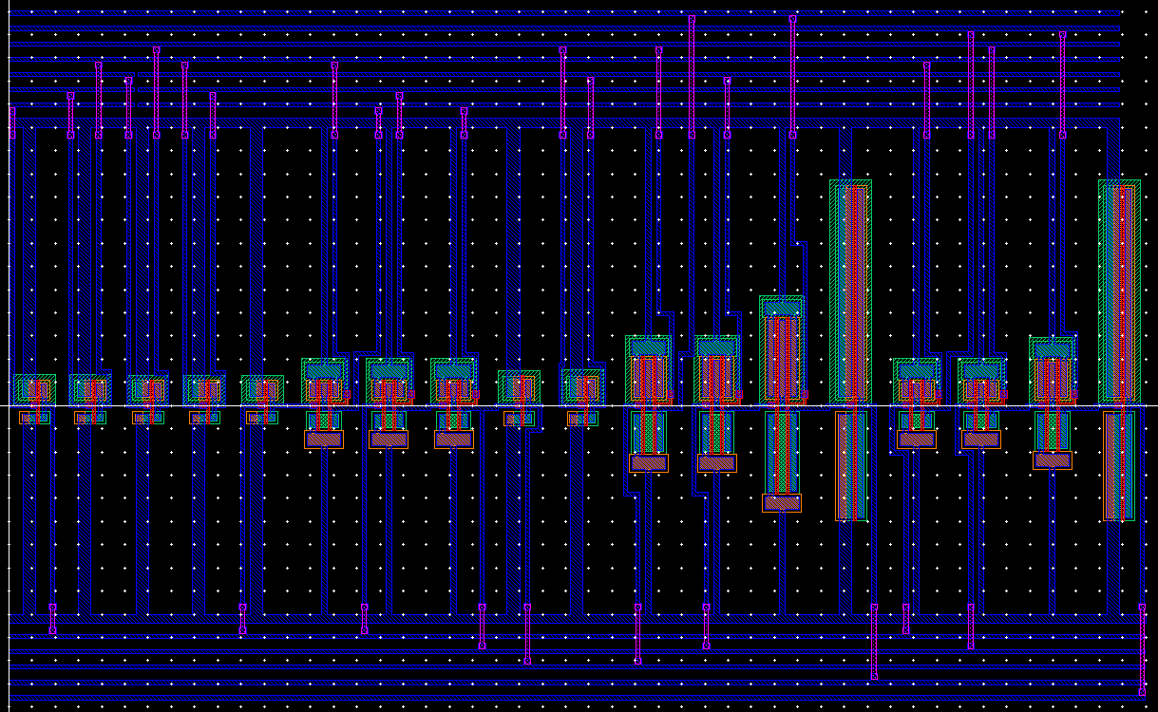
Snap-together Standard Cells Circuit Layout

Slide 21
Questions?

